Slide 1

Virtual Franciscan Ecumenical Advocacy Days Gathering
A celebration the 50th Anniversary of Mother Earth Day and 5th Anniversary of Laudato Si

Slide 2
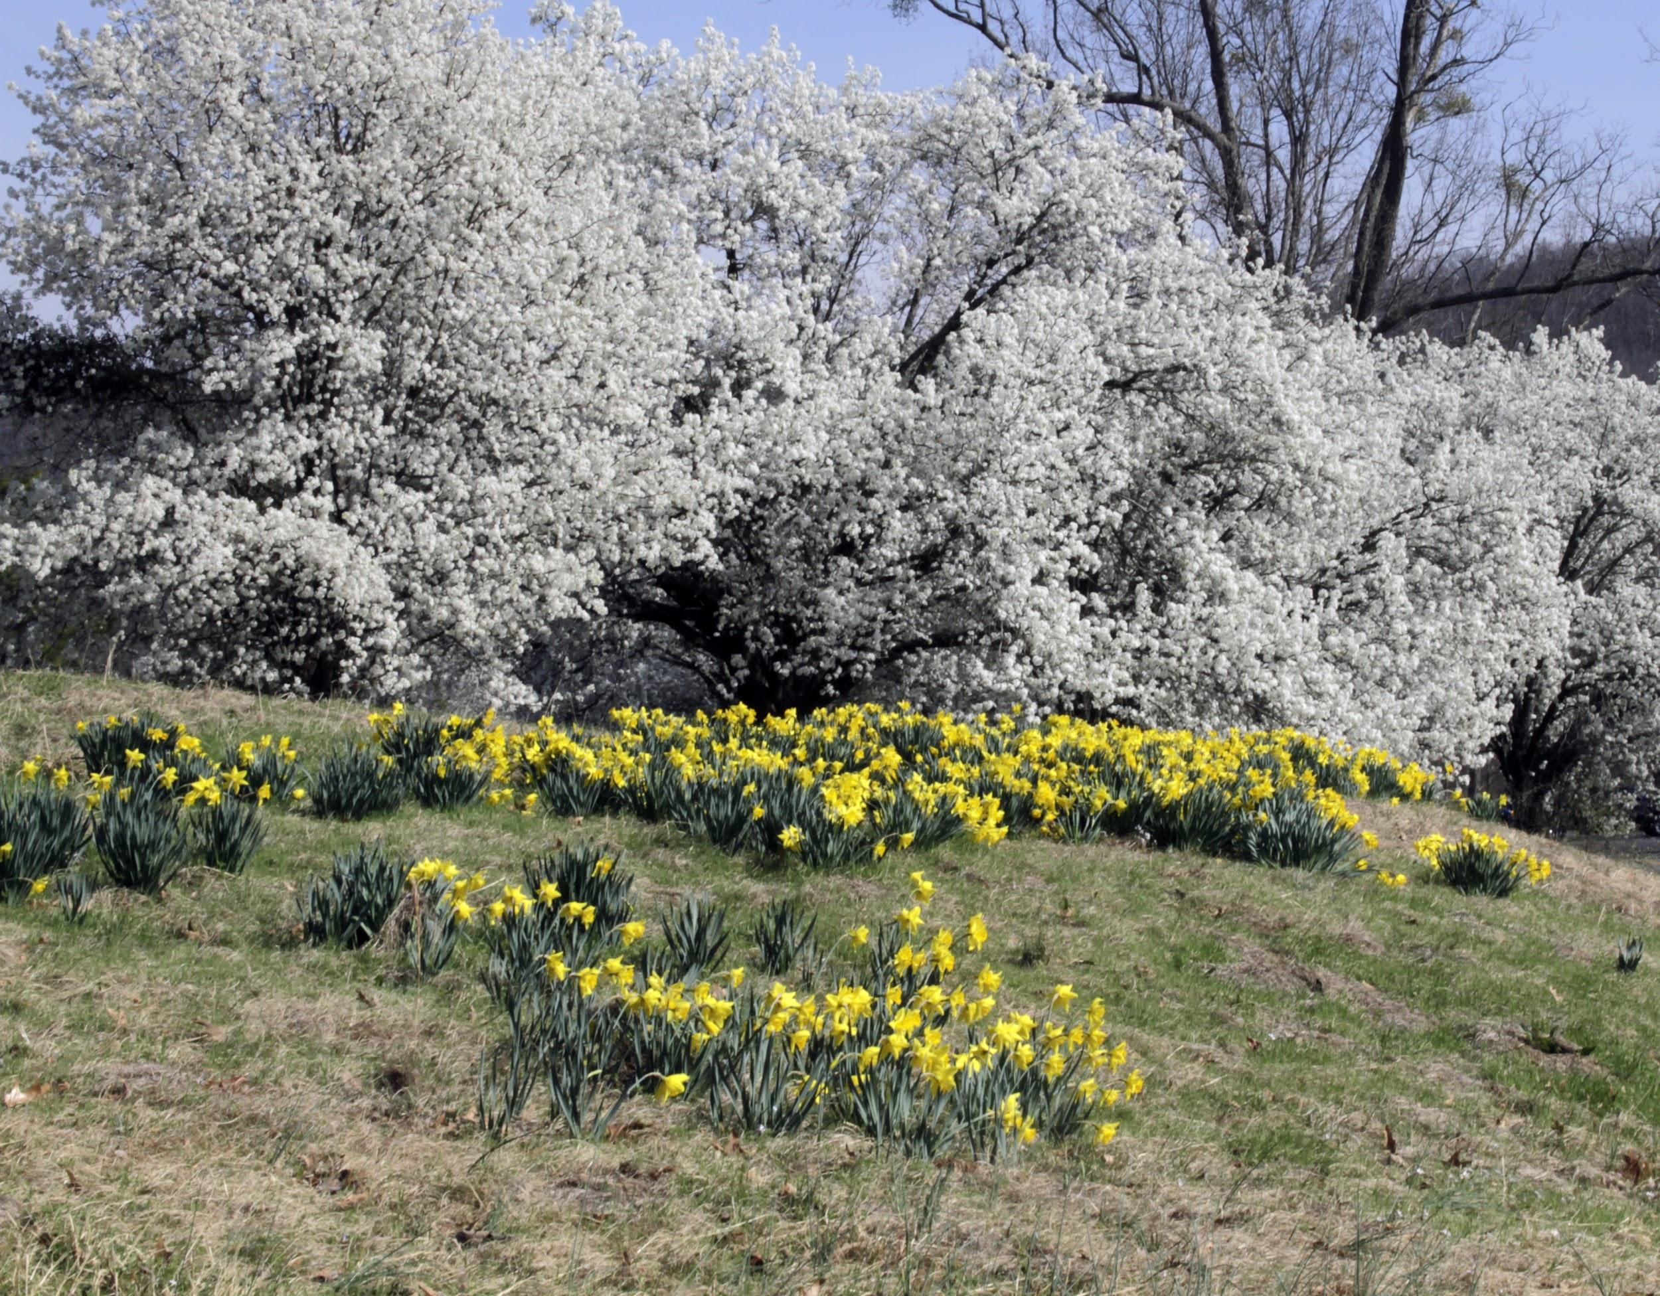
Thank you for joining us!
We will begin the call shortly.
All participants are muted to reduce background noise.

Slide 3
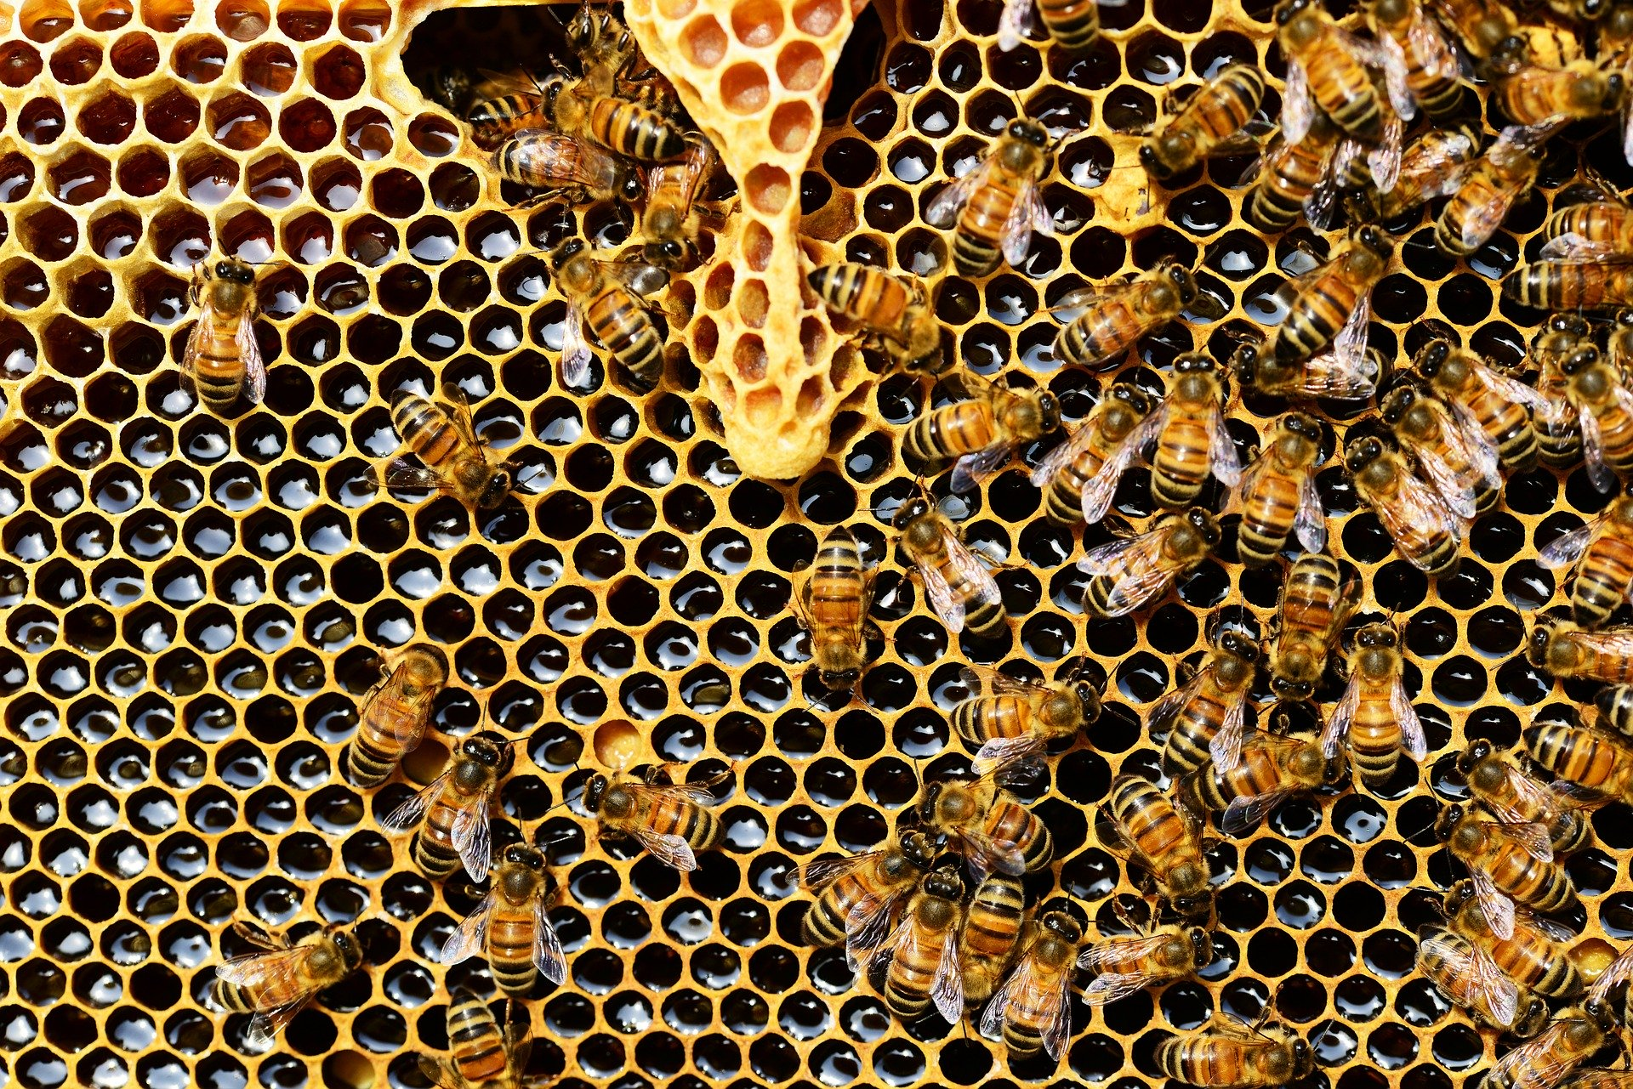
Logistics
Please use Chat box for questions
On Facebook, post your questions in the comment section
Everyone is muted

Slide 4
Take Action: Contact your members of Congress
Contact your members of Congress via email and tell them to pass legislation to stop the EPA from rolling back important environmental regulations: https://franciscanactionnetwork.salsalabs.org/opposeeparollbacks20/index.html
Want to do more than email? Take the St. Clare Pledge and call their offices--even better if you call their in district offices! For more info: https://franciscanaction.org/take-the-st-clare-pledge

Slide 5

Take Action: Tips, Ideas, Further Suggestions
You can email your Rep. more than once
Don’t be afraid to call: you can even call after hours and leave a voicemail
Sometimes contacting local offices is even more effective
During our “new normal” all rules are out the window: calls are typically most effective but some offices might not be fully staffed or answering the phone
Consider new ways to reach your elected officials: A letter to the editor or “virtual office visit”
FAN staff can help with these ideas!

Slide 6

Upcoming Webinars of Interest
FAN is a leader with the Faithful Democracy coalition. We are hosting a town hall to hear how the faith community is mobilizing to ensure that the 2020 elections are safe and fair in the context of COVID-19. Register at: networklobby.org/townhall
Wednesday April 29th at 12pm ET / 9am PT
Ecumenical Advocacy Days 2020 has gone virtual. A free webinar will take place on what would have been EAD Lobby Day to find ways to meet the immediate needs of those most severely affected by COVID-19. Register at: https://advocacydays.org/
Monday, April 27th at 1 pm ET / 10 am PT.

Slide 7
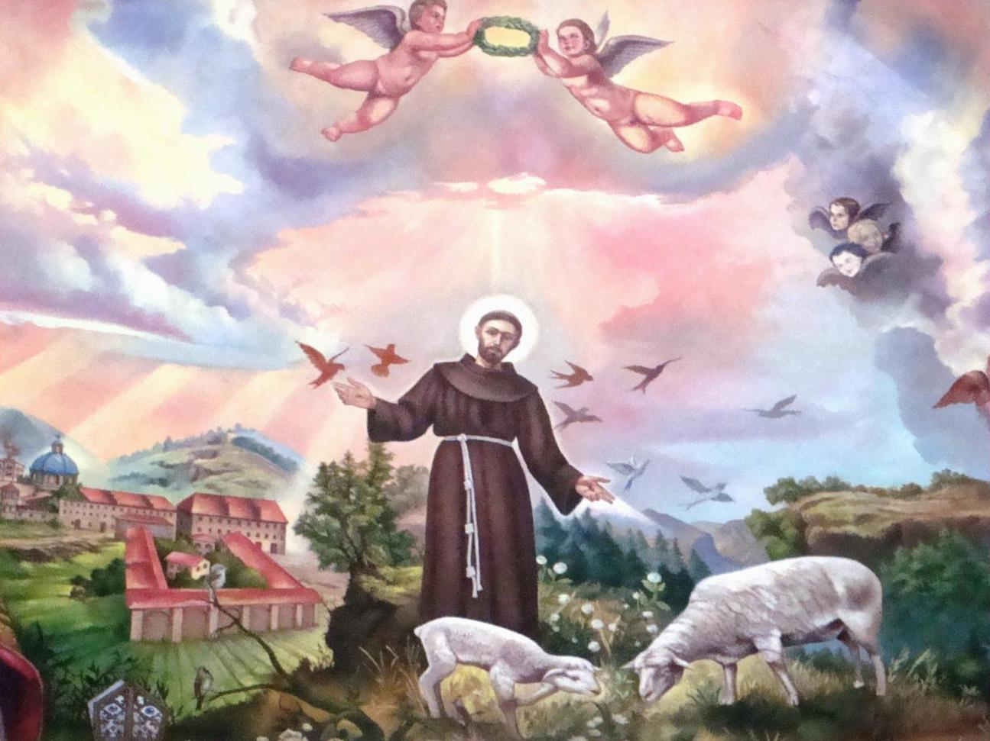
Canticle of Creatures
Please join us as we pray:

Slide 8
Canticle of Creatures:
Most High, all-powerful, good Lord,
Yours are the praises,
the glory, and the honor, and all blessing.
To You alone, Most High, do they belong,
and no human is worthy to mention Your name.
Praised be You, my Lord, with all Your creatures,
especially Sir Brother Sun, who is the day and through whom You give us light.
And he is beautiful and radiant with great splendor;
and bears a likeness of You, Most High One.
Praised be You, my Lord, through Sister Moon and the stars,
in heaven You formed them clear and precious and beautiful.
Praised be You, my Lord, through Brother Wind,
and through the air, cloudy and serene, and every kind of weather,
through whom You give sustenance to Your creatures.
Praised be You, my Lord, through Sister Water,
who is very useful and humble and precious and chaste.

Slide 9
Canticle of Creatures (cont.):
Praised be You, my Lord, through Brother Fire,
through whom You light the night,
and he is beautiful and playful and robust and strong.
Praised be You, my Lord, through our Sister Mother Earth,
who sustains and governs us,
and who produces various fruit with colored flowers and herbs.
Praised be You, my Lord,
through those who give pardon for Your love,
and bear infirmity and tribulation.
Blessed are those who endure in peace
for by You, Most High, shall they be crowned.
Praised be You, my Lord, through our Sister Bodily Death,
from whom no one living can escape. Woe to those who die in mortal sin.
Blessed are those whom death will find in Your most holy will,
for the second death shall do them no harm.
Praise and bless my Lord and give Him thanks and serve Him with great humility. Amen.

Slide 10
Find us online:
Sign up for our newsletter on our website:
https://franciscanaction.org/
Facebook:
https://www.facebook.com/franciscanactionnetwork/
Twitter:
https://twitter.com/franciscannet
Instagram:
https://www.instagram.com/franciscannet/
Peace and All Good!

